Slide 1

WELCOME
Membership Management Software

Slide 2


100 % Repeat Business
97% Client Retension
72% Client Conversion Ratio
16% Employee Turnover Rate
Avg Employement Life 5 years

Slide 3
Automated Process Outshines a Manual Process
Believe it or not...
Not too long ago, to indulge in a rejuvenating cup of coffee, we had to wake up and fumble around with the coffee maker with one eye open as we tried to rouse ourself.
But with programmable coffee makers, we can wake up to a promising cup of joy and jumpstart our day.
Businesses have a similar option now: continue to slog through manual processes or significantly improving work with automated processes.
In a 2018 survey of over 280 companies in the US, 62 percent of respondents reported three or more process inefficiencies that could be resolved with automation.
The survey found that managers spend at least 8 hours a week on an average in manual data tasks.
In fact, 25 percent reported spending 20 hours a week on manual data tasks!

Slide 4

Manual Process Vs. Automated Processes
If this makes you wonder , let me take you a look through a comparison
How or why automated processes are an improvement over manual processes.

Slide 5
Manual process apart from an Automated one
Manual Process
Automated Process
How it is managed
Reminders
Starting
Form completion
Tracking
Audit Trail
Requires a human to push it through every step
Must be send by human one by one
Physical or digital forms are kept in disparate places
All information / data must be completed manually which consumes time
Must send messages to others to determine status and where the items are
Completion events are easy to falsify & might miss information
The system is programmed to Auto- assigns tasks
System can send an emails/ notifications at specified time
All digital forms / information kept in the same place
Fields that contains regular data / repeat calculations can be auto fill which saves time
System auto saves & keeps a log of the status of items which is accessible to anywhere, anyone , anytime
The system logs every action with the accurate time

Slide 6
Automation in Action
Let’s describe a typical Membership Application from a manual as well as an automated perspective.
Let’s say we need to address Membership applications for few new Individuals / Company / Firms.
In the manual process, we would either find the paper version of the membership application form or download a digital form through an online process. Then, we need to fill out every detail and scan each and every document.
We need to send then handwritten receipt scan copy by an email to the respected one against their payment. Further need to input in excel sheet the same details which filled on the said application on its paper version along with the reports for the management.
We then need to get it approve and send the Certificate along with the tax invoice again scan copy to the respected member on its register address and through an Email.
However, there are a lot of holes in this process. First, the form may have lots of fields and opportunities for data transfer errors. Second, there’s no way for us to check to see how far along the process is. Again Data security and accuracy is also an issue as we need to make sure no one tampers with the numbers, documents, data and the application is accurate.
Automation can plug all of these holes and gives us much more confidence in the process by trusting that every task was completed and the data is accurate.

Slide 7
Some Benefits of Automating Manual Processes
Irrespective of industry type ,an automated process can bring the following benefits.
Clarity : Automation necessitates a clear and complete understanding of how the process works and who is involved.
Higher efficiency : An automated process minimizes errors resulting in higher efficiency.
Better customer experience : An automated processes falls into accurate & fast service, making customer happy.
Reduced time and costs : With faster turnaround and elimination of wasteful practices, automated processes facilitate time and cost savings.
Efficient allocation of resources : Since routine tasks are taken care of with automation, employees can be reassigned to do high-value work.
Insight : Workflow automation software helps us to gain deep insight into our processes with analytics and reports, thereby aiding decision-making.
Transparency and accountability : Automated processes keep all stakeholders in the loop, increasing transparency. Status reports keep everyone individually accountable.

Slide 8
OFFICE 360 – MEMBERSHIP SOFTWARE
Building healthy relationship with Member
Increase in Business
Building healthy relationship with an Employee
Increase in Productivity
Helps in Marketing our Brands in minimal Cost

Slide 9
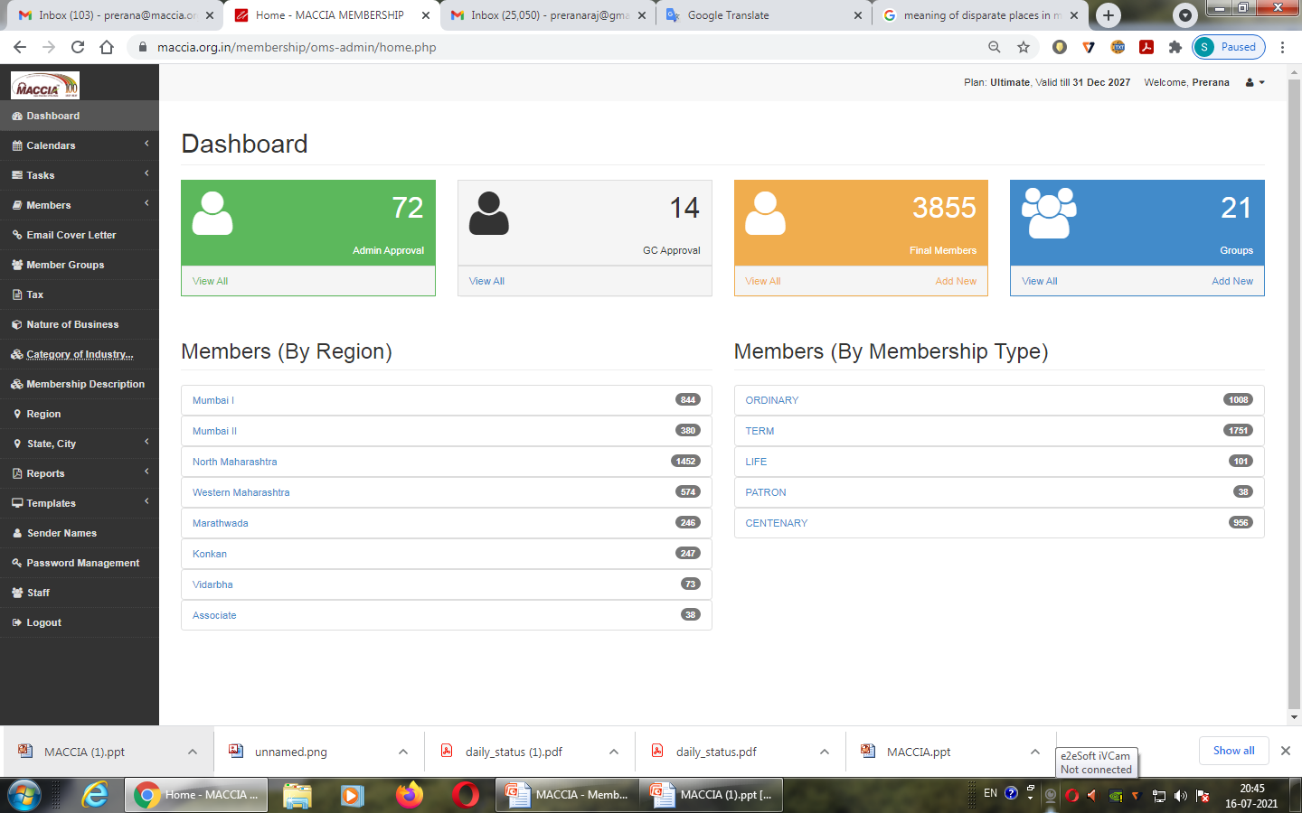
OFFICE 360 – MEMBERSHIP SOFTWARE
STRUCTURE OF SOFTWARE

Slide 10
OFFICE 360 – MEMBERSHIP SOFTWARE
DEPARTMENTS COVERED
RECEPTION
ACCOUNTS
STAFF SELF ASSESMENT
MEMBERSHIP
MAIN ACTIVITIES COVERED
Membership Data management
Staff Task Management : Individual and Collective task (Group task)
Templates , Cover letters & Automated Emails for receipts , Proformas, Tax invoices &
Membership Certificates
Inward & Outward tracking
Dashboard for summary
Birthday calendar & Telephone directory of GC members , Staff & Senior management
Various summary and detailed reports like active members report , new members report,
collection report, membership expiry report, GSTN report, outstanding report, Inward
outward register etc.

Slide 11
OFFICE 360 – MEMBERSHIP SOFTWARE
Upcoming Modules Target Date : 15th August 2021
Meeting management
Internal management
Visit Management
Follow up Module
HR Module
Event Management
Certificate of Origin process
Venue Booking Management
Accounts Module( Rest membership activities )

Slide 12
OFFICE 360 – MEMBERSHIP SOFTWARE
RECEPTION DEPARTMENT
AS IN PROCESS ( MANUAL Activities )
Entering Inward Stuff
Entering Outward Stuff
GC members calling for meeting confirmation and remarks thereof
Venue booking and reports thereof
Visitors entry and management
Telephone directory
Follow ups for outstanding from members, documents etc
Internal meeting arrangements
Document scanning
Attending walk-ins
Routine task weekly report ( Self Assessment)

Slide 13
OFFICE 360 – MEMBERSHIP SOFTWARE
RECEPTION DEPARTMENT
OFFICE 360 (Automated process )
Inward Outward record maintenance
Follow up module
Telephone directory
Routine task & Group Task weekly ( Self Assessment)
Reports :
Inward & Outward Register
Birthday Calendar
Telephone Directory
Routine & Group task report ( Individual )

Slide 14
OFFICE 360 – MEMBERSHIP SOFTWARE
ACCOUNTS DEPARTMENT
AS IN PROCESS ( MANUAL Activities )
Membership records maintenance in Tally
Preparing receipts after payment
Proforma invoice for payment reminder
Tax Invoice after receipt of payment
GSTN report preparation
Outstanding report Preparation
Other payment entries
FDR management and renewals
Routine task weekly report ( Self Assessment)

Slide 15
OFFICE 360 – MEMBERSHIP SOFTWARE
ACCOUNTS DEPARTMENT
OFFICE 360 (Automated process )
Membership Data management in Office 360
Receipts auto generate and send to member
Proforma auto generate and send to member
Tax invoice auto generate and send to member
FDR management – in process target date 15th August 2021
Reports :
GSTN Report
Outstanding Report
Total New membership collection report
Total Renewal collection report
Total tax collection from membership reports
Routine & Group task report ( Individual )

Slide 16
OFFICE 360 – MEMBERSHIP SOFTWARE
MEMBERSHIP DEPARTMENT
AS IN PROCESS ( MANUAL Activities )
Addressing New Membership Records
Renewal & new Membership update in Excel worksheet after receipt of payment
Registering and approval process along with documents of new memberships
Membership Certificate after GC approval
Region wise / District wise / Proposer wise data maintenance in Excel
Introductory Email with all types of our membership benefits to new approach
Welcome letter after approval of application
Preparing receipts after payment and send process through an Email
Routine task weekly report ( Self Assessment)

Slide 17
OFFICE 360 – MEMBERSHIP SOFTWARE
MEMBERSHIP DEPARTMENT
OFFICE 360 (Automated process )
Dashboard ( Membership Summary )
Membership data
Receipts auto generate and send to member
Proforma auto generate and send to member
Tax invoice auto generate and send to member
Introductory Email with membership benefits
Event Calendar ( Meeting , Seminar, Functions, Festivals , Conferences)
Label printing
Dashboard ( Membership Summary )
Reports :
GSTN Report
Outstanding Report
Membership Expiry Report
Cancel member summary ( In progress)
Total New membership collection report
Total Renewal collection report
Total tax collection from membership reports
Routine & Group task report ( Individual )

Slide 18
Thank You !
Ultraliant Infotech Pvt. Ltd.
5, Nilesh, Sharanpur Road, Nashik– 422002,
Maharashtra, India
http://www.ultraliant.com
India Contact:
E-mail: swapnil@ultraliant.com Cell: +91 8380037808
Phone: +91 253 4035466
Looking Forward to a Mutually Beneficial Relations...

